Slide 1
Unit 6
Logic Based System

Slide 2
Topics
Malicious logic
Vulnerability analysis
Auditing
Intrusion detection
Applications: Network security, operating system security, user security, program security
Special Topics: Data privacy, introduction to digital forensics, enterprise security specification.

Slide 3
Malicious logic
Malicious logic is a set of instructions that cause a site’s
security policy to be violated.

Slide 4
Forms of Malicious Logic
Trojan Horses
Computer Viruses
Boot Sector Infectors
Executable Infectors
Multipartite Viruses
TSR Viruses
Stealth Viruses
Encrypted Viruses
Polymorphic Viruses
Macro Viruses
Computer Worms
Other Forms of Malicious Logic
Rabbits and Bacteria
Logic Bombs

Slide 5
Trojan Horses
Trojan horse is a program with an overt (documented or known) effect and a covert (undocumented or unexpected) effect.
A propagating Trojan horse (also called a replicating Trojan horse) is a Trojan horse that creates a copy of itself.
EXAMPLE: The following UNIX script is named ls and is placed in a directory.
cp /bin/sh /tmp/.xxsh
chmod u+s,o+x /tmp/.xxsh
rm ./ls
ls $*
It creates a copy of the UNIX shell that is setuid to the user executing this program This program is deleted, and then the correct ls command is executed. On most systems, it is against policy to trick someone into creating a shell that is setuid to themselves. If someone is tricked into executing this script, a violation of the (implicit) security policy occurs. This script is an example of malicious logic.

Slide 6
EXAMPLE
The NetBus program allows an attacker to control a Windows NT workstation remotely. The attacker can intercept keystrokes or mouse motions, upload and download files, and act as a system administrator would act.
In order for this program to work, the victim Windows NT system must have a server with which the NetBus program can communicate. This requires someone on the victim’s system to load and execute a small program that runs the server.
This small program was placed in several small game programs as well as in some other “fun” programs, which could be distributed to Web sites where unsuspecting users would be likely to download them.

Slide 7
Computer Viruses
computer virus is a program that inserts itself into one or more files and then performs some (possibly null) action.
This type of Trojan horse propagates itself only as specific programs When the Trojan horse can propagate freely and insert a copy of itself into another file, it becomes a computer virus.
The first phase, in which the virus inserts itself into a file, is called the insertion phase. The second phase, in which it performs some action, is called the execution phase. The NEXT pseudocode fragment shows how a simple computer virus works.

Slide 8
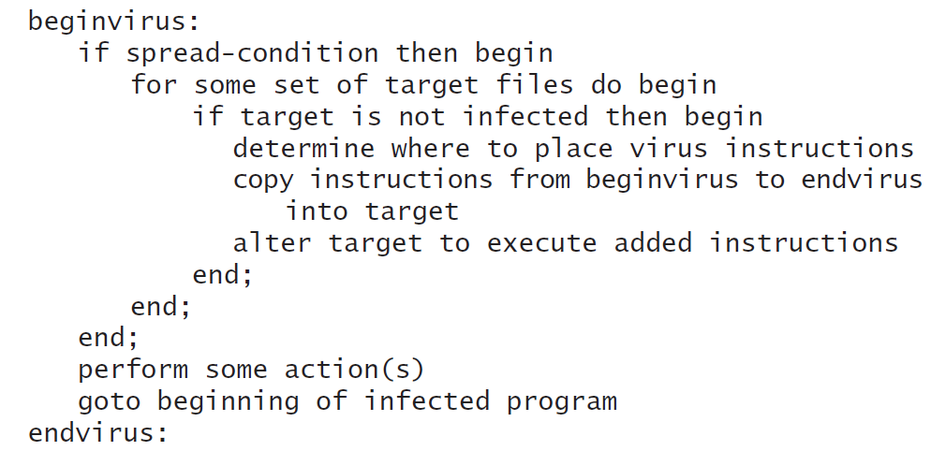
Example :As this code indicates, the insertion phase must be present but need not always be executed. It would check for an uninfected boot file (the spread-condition mentioned in the pseudocode) and, if one was found, would infect that file (the set of target files). Then it would increment a counter and test to see if the counter was at 4. If so, it would erase the disk. These operations were the action(s).

Slide 9
Boot Sector Infectors
The boot sector is the part of a disk used to bootstrap the system or mount a disk.
Code in that sector is executed when the system “sees” the disk for the first time. When the system boots, or the disk is mounted, any virus in that sector is executed.
A boot sector infector is a virus that inserts itself into the boot sector of a disk.
Eg - The Brain virus for the IBM PC is a boot sector infector. When the system boots from an infected disk, the virus is in the boot sector and is loaded. It moves the disk interrupt vector (location 13H or 19) to an alternative interrupt vector (location 6DH or 109) and sets the disk interrupt vector location to invoke the Brain virus now in memory. It then loads the original boot sector and continues the boot.

Slide 10
Example
The Brain (or Pakistani) virus, written for IBM PCs, is thought to have been created in early 1986 but was first reported in the United States in October 1987. It alters the boot sectors of floppy disks, possibly corrupting files in the process. It also spreads to any uninfected floppy disks inserted into the system. Since then, numerous variations of this virus have been reported.

Slide 11
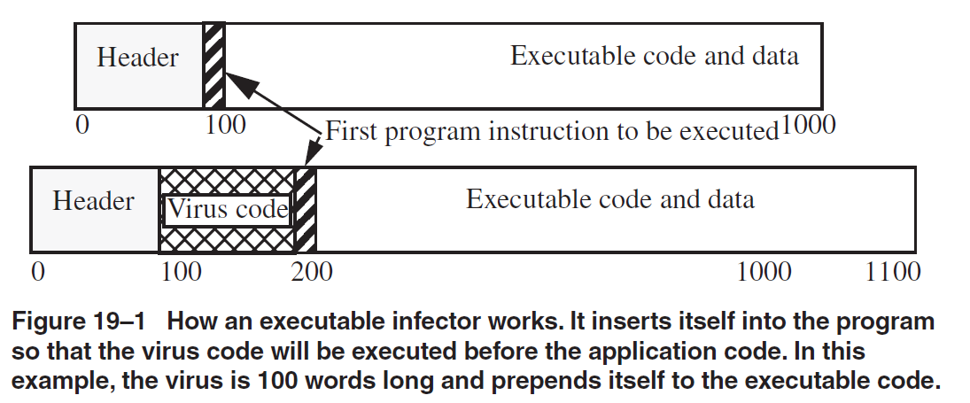
Executable Infectors
An executable infector is a virus that infects executable programs.
The PC variety of executable infectors are called COM or EXE viruses because they infect programs with those extensions. Figure 19–1 illustrates how infection can occur. The virus can prepend itself to the executable (as shown in the figure) or append itself.

Slide 12
Multipartite Viruses
multipartite virus is one that can infect either boot sectors or applications.
Such a virus typically has two parts, one for each type. When it infects an executable, it acts as an executable infector; when it infects a boot sector, it works as a boot sector infector.

Slide 13
TSR Viruses
A terminate and stay resident (TSR) virus is one that stays active (resident) in memory after the application (or bootstrapping, or disk mounting) has terminated.
TSR viruses can be boot sector infectors or executable infectors. Eg – Brain Virus

Slide 14
Stealth Viruses
Stealth viruses are viruses that conceal the infection of files.
Example - The Stealth virus (also called the IDF virus or the 4096 virus) is an executable infector. It modifies the DOS service interrupt handler (rather than the interrupt vector; this way, checking the values in the interrupt vector will not reveal the presence of the virus).

Slide 15
Polymorphic Viruses
A polymorphic virus is a virus that changes its form each time it inserts itself into another program.
Macro Viruses
A macro virus is a virus composed of a sequence of instructions that is interpreted, rather than executed directly.
For example, a spreadsheet virus executes when the spreadsheet interprets these instructions. If the macro language allows the macro to access files or other systems, the virus can access them, too.

Slide 16
Computer Worms
A computer virus infects other programs. A variant of the virus is a program that spreads from computer to computer, spawning copies of itself on each one.
A computer worm is a program that copies itself from one computer to another.

Slide 17
Other forms of malicious Logic
Rabbits and Bacteria
Some malicious logic multiplies so rapidly that resources become exhausted. This creates a denial of service attack.
A bacterium or a rabbit is a program that absorbs all of some class of resource.
Logic Bombs
A logic bomb is a program that performs an action that violates the security policy when some external event occurs

Slide 18
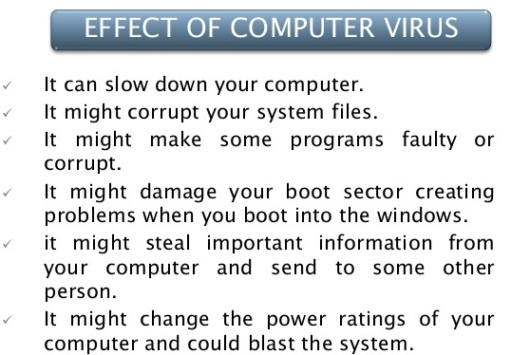

Slide 19
Vulnerability analysis

Slide 20
Vulnerability analysis
A vulnerability assessment is the process of identifying, quantifying, and prioritizing the vulnerabilities in a system.
A vulnerability analysis is a review that focuses on security-relevant issues that either moderately or severely impact the security of the product or system.

Slide 21
Steps to conducting a proper vulnerability assessment
Identify where your most sensitive data is stored.
Uncover hidden sources of data.
Identify which servers run mission-critical applications.
Identify which systems and networks to access.
Review all ports and processes and check for misconfiguration.

Slide 22
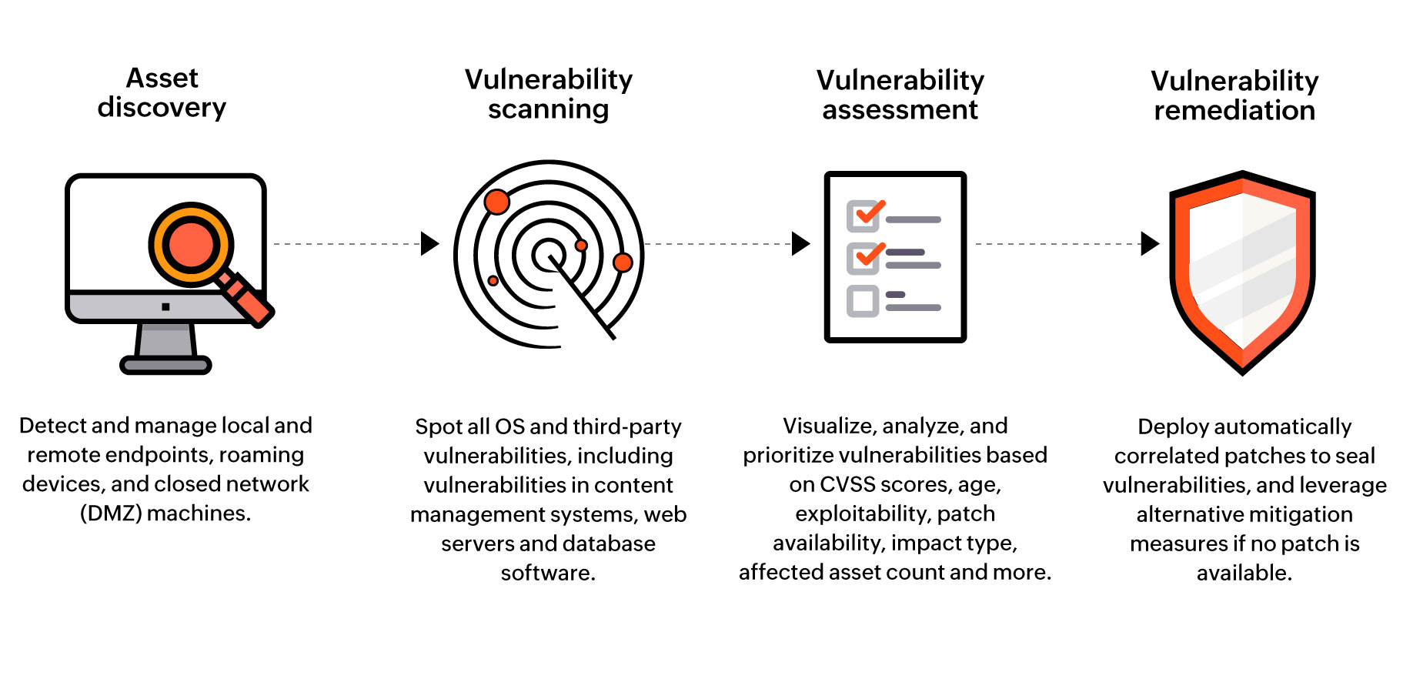
Steps to vulnerability analysis

Slide 23
Auditing
An information technology audit, or information systems audit, is an examination of the management controls within an Information technology infrastructure and business applications.

Slide 24
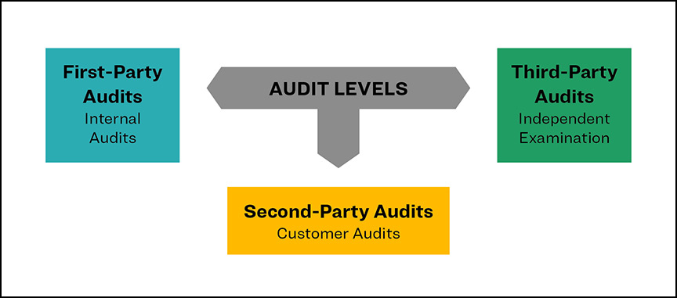

Slide 25
IT Audit strategies
Review IT organizational structure.
Review IT policies and procedures.
Review IT standards.
Review IT documentation.
Review the organization's BIA.
Interview the appropriate personnel.
Observe the processes and employee performance.

Slide 26
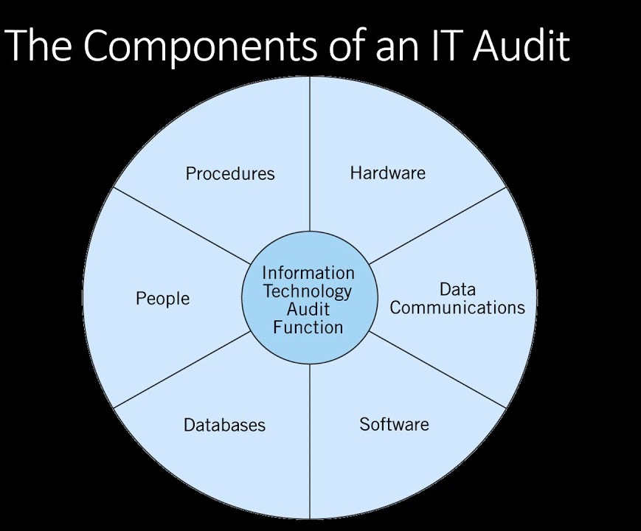

Slide 27
Intrusion Detection System

Slide 28
An intrusion detection system is a device or software application that monitors a network or systems for malicious activity or policy violations.
Any intrusion activity or violation is typically reported either to an administrator or collected centrally using a security information and event management system.

Slide 29
Intrusion detection systems primarily use two key intrusion detection methods: signature-based intrusion detection and anomaly-based intrusion detection
A NIDS system operates at the network level and monitors traffic from all devices going in and out of the network.
NIDS performs analysis on the traffic looking for patterns and abnormal behaviours upon which a warning is sent.

Slide 30
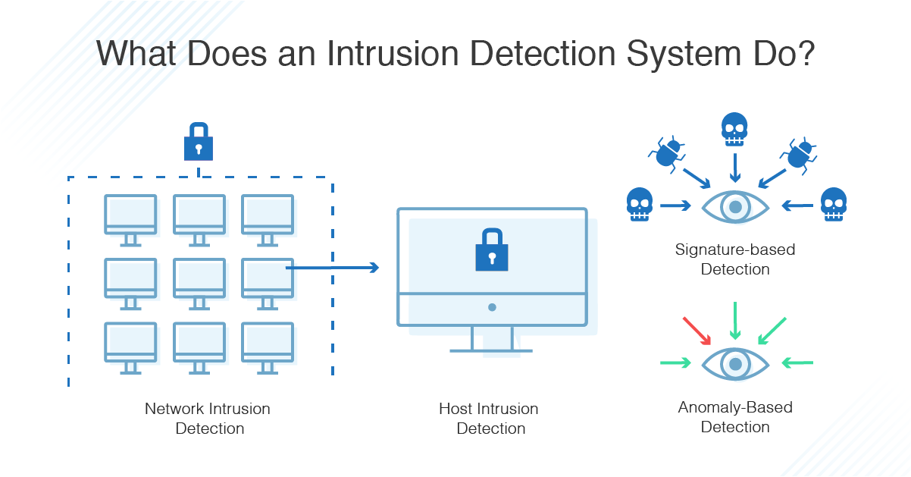

Slide 31
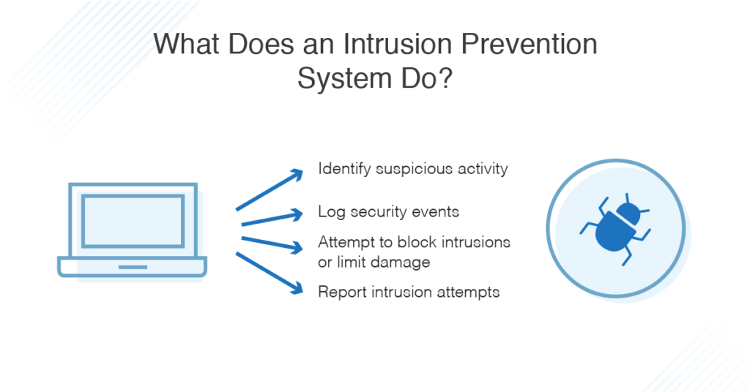

Slide 32
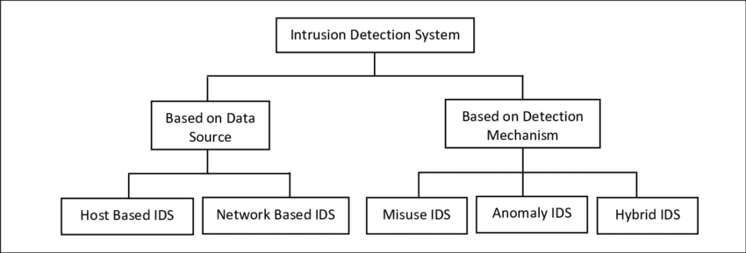

Slide 33
Network security

Slide 34
Network security is a broad term that covers a multitude of technologies, devices and processes.
In its simplest term, it is a set of rules and configurations designed to protect the integrity, confidentiality and accessibility of computer networks and data using both software and hardware technologies.

Slide 35
Types of Network Security Protections
Firewall.
Network Segmentation.
Remote Access VPN.
Email Security.
Data Loss Prevention (DLP)
Intrusion Prevention Systems (IPS)
Sandboxing.

Slide 36
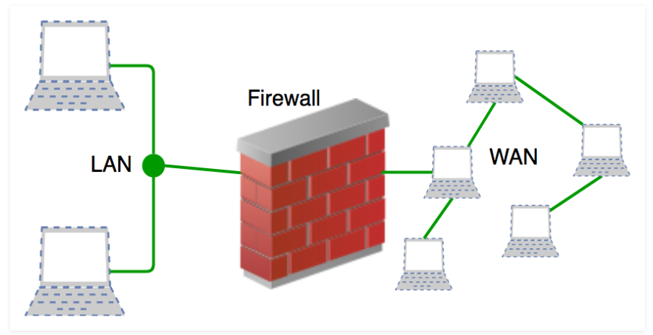
Firewall
A firewall is a network security system that monitors and controls incoming and outgoing network traffic based on predetermined security rules. A firewall typically establishes a barrier between a trusted network and an untrusted network, such as the Internet.
a defined set of security rules it accepts, rejects or drops that specific traffic.
Accept : allow the traffic Reject : block the traffic but reply with an “unreachable error” Drop : block the traffic with no reply

Slide 37
Network Segmentation
Network segmentation in computer networking is the act or practice of splitting a computer network into subnetworks, each being a network segment. Advantages of such splitting are primarily for boosting performance and improving security.
Example : Imagine a large bank with several branch offices. The bank's security policy restricts branch employees from accessing its financial reporting system. Network segmentation can enforce the security policy by preventing all branch traffic from reaching the financial system. And by reducing overall network traffic, the financial system will work better for the financial analysts who use it.

Slide 38
Remote Access VPN
In a Remote-access VPNs, individual hosts or clients, such as telecommuters, mobile users, and extranet consumers, are able to access a company network securely over the Internet. Each host typically has VPN client software loaded or uses a web-based client.
VPNs can be characterized as host-to-network

Slide 39
Email Security
Email security refers to various cybersecurity measures to secure the access and content of an email account or service.
Email security is important because malicious email is a popular medium for spreading ransomware, spyware, worms, different types of malware, social engineering attacks like phishing or spear phishing emails and other cyber threats.

Slide 40
Data loss prevention
Data loss prevention (DLP) software detects potential data breaches/data ex-filtration transmissions and prevents them by monitoring, detecting and blocking sensitive data while in use (endpoint actions), in motion (network traffic), and at rest (data storage). The terms "data loss" and "data leak" are related and are often used interchangeably
Prevention by :
Database Hardening. One of the best ways to prevent data loss is to secure a database by hardening it as much as possible.
Manage Database Access Tightly. ...
Secure Authentication. ...
Secure Communication. ...

Slide 41
IPS
An intrusion prevention system (IPS) is a form of network security that works to detect and prevent identified threats.
Intrusion prevention systems continuously monitor your network, looking for possible malicious incidents and capturing information about them.
The IPS reports these events to system administrators and takes preventative action, such as closing access points and configuring firewalls to prevent future attacks.
IPS solutions can also be used to identify issues with corporate security policies, deterring employees and network guests from violating the rules these policies contain.

Slide 42
Operating system security

Slide 43
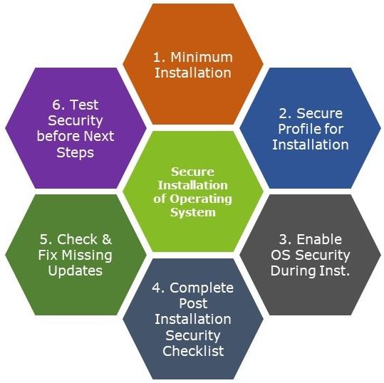

Slide 44
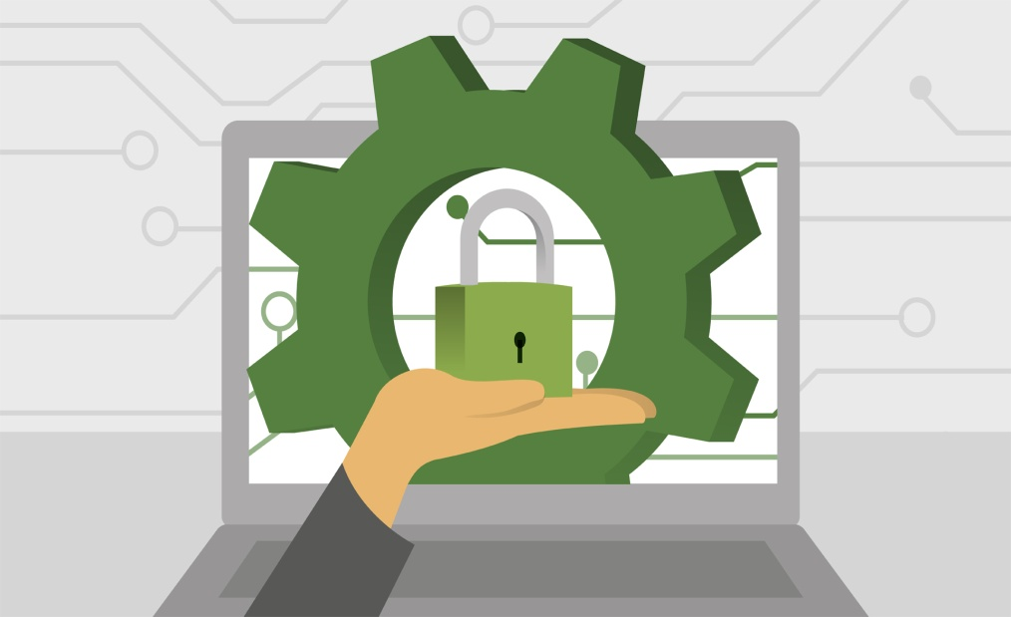
Operating system security
Operating system security (OS security) is the process of ensuring OS integrity, confidentiality and availability.
OS security refers to specified steps or measures used to protect the OS from threats, viruses, worms, malware or remote hacker intrusions

Slide 45
Protected Objects
• Hardware, software and data.
• Memory.
• Sharable I/O devices.
• Serially reusable I/O devices.
• Sharable programs and sub-procedures.
• Sharable data.
As it assumed responsibility for controlled sharing, the operating system had to protect these objects.

Slide 46
User Security

Slide 47
User security awareness training helps every employee in your organization recognize, avoid, and report potential threats that can compromise critical data and systems, including phishing, malware, ransomware, and spyware.

Slide 48
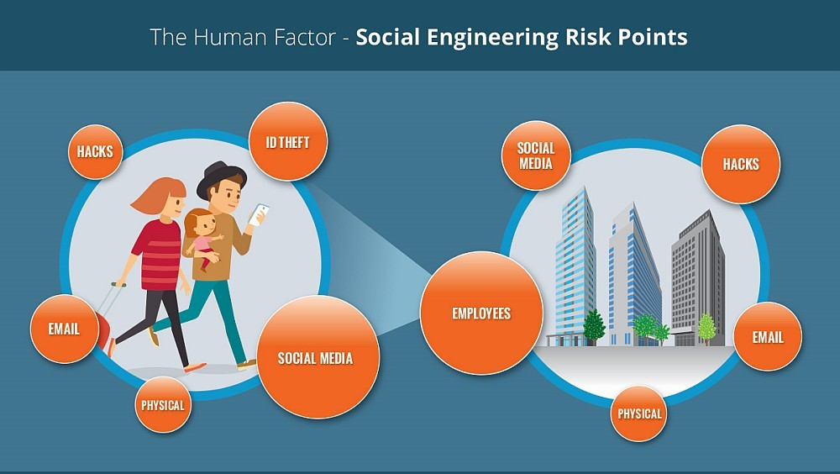

Slide 49
Securing user account
Use a long/secure password.
Do not reuse or share passwords.
Use Two-Factor Authentication (2FA) .
Use a password management application.
Check web site security.

Slide 50
Program Security

Slide 51
A security program is the entirety of an organization's security policies, procedures, tools and controls.
Protection from an unauthorized access to the system.
Strict allocation of user roles and their access to certain data.
Protection of the stored and processed data from damage and loss

Slide 52
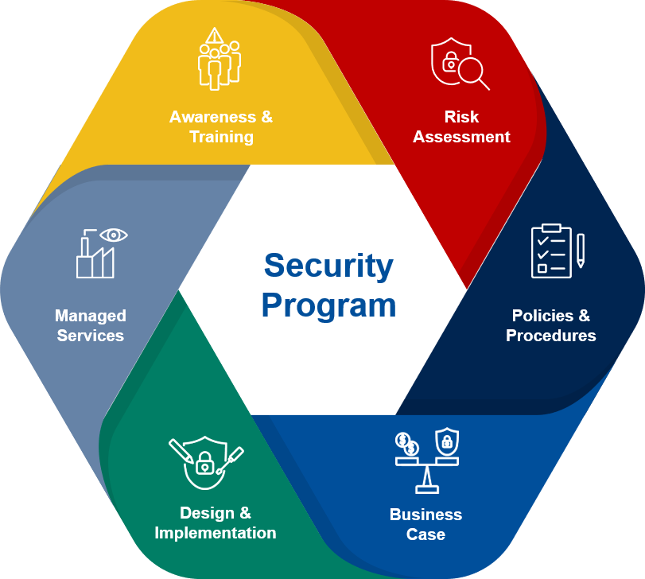

Slide 53
Application Security

Slide 54
Application security is the process of developing, adding, and testing security features within applications to prevent security vulnerabilities against threats such as unauthorized access and modification.
Examples of application security features.
Authentication,
authorization,
encryption,
logging,
application security testing

Slide 55
Application Security Tools are designed to protect software applications from external threats throughout the entire application lifecycle.
The purpose of this class of tools is to protect the many different kinds of application against data theft or other nefarious intent.

Slide 56
Building secure applications: Top 10 application security best...
Follow the OWASP top ten.
Get an application security audit.
Implement proper logging.
Use real-time security monitoring and protection.
Encrypt everything.
Harden everything. (hardening is usually the process of securing a system by reducing its surface of vulnerability, which is larger when a system performs more functions; in principle a single-function system is more secure than a multipurpose one.)
Keep your servers up to date.
Keep your software up to date

Slide 57
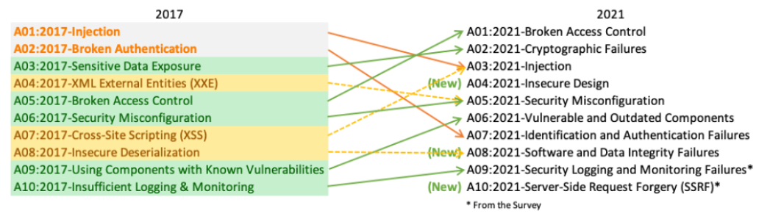
OWASP stands for Open Web Application Security Project.

Slide 58
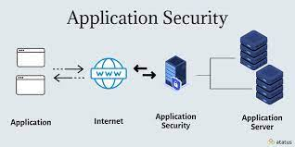

Slide 59
Digital Privacy

Slide 60

Digital privacy (also internet or online privacy) means the protection of any data a user creates or transmits while navigating the web via a mobile or desktop.

Slide 61
The concept of digital privacy can best be described as the protection of the information of private citizens who use digital mediums.
Information such as the date and time of his searches, what browser he used to access websites and even how long he viewed websites can be retained on a search engine's servers

Slide 62
Digital Forensics

Slide 63
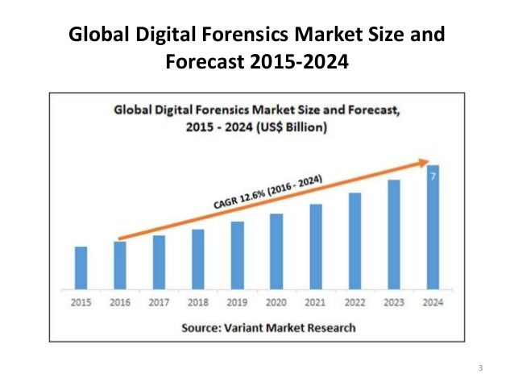

Slide 64
What is Forensics ?
Collection and analysis of evidence.
Using scientific test or techniques.
To establish facts against crime.
For presenting in a legal proceeding.
Therefore Forensic science is a scientific method of gathering and examining information about the past which is then used in court of law.

Slide 65
Digital Forensics
Digital Forensics deals with the process of finding evidence related to a digital crime.
It is a science of finding evidence from digital media like a computer, mobile phone, server, or network.
It provides the forensic team with the best techniques and tools to solve complicated digital-related cases.

Slide 66
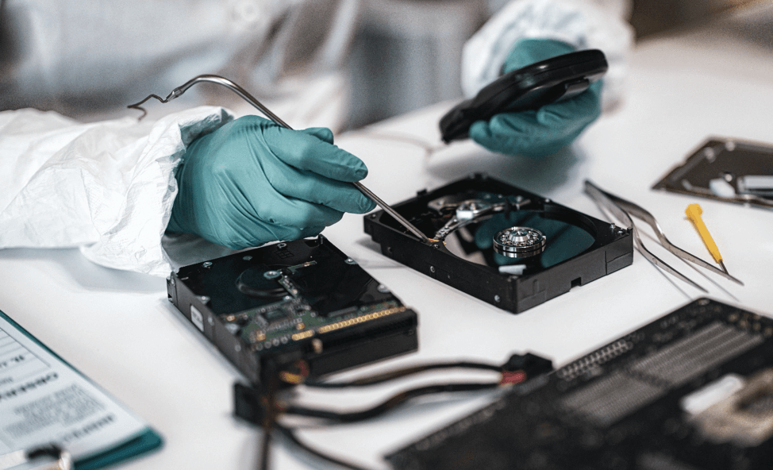

Digital Forensics Specialists are generally consulted to investigate cyber-crimes, crimes that involve a security breach in a system or network.
When a cyber-crime occurs, digital forensics specialists can assist in various ways.

Slide 67

Investigation Carried by:
Law Enforcement officials.
Investigation Departments.
Civil Litigations.
Insurance Companies.
Private Corporations.
Individual/Private Citizens.

Slide 68

Use-Cases of Digital Forensics
Banking credit/debit card related crimes.
Data Recovery.
Financial Fraud Investigation.
Damage control in the wake of cybercrime.
Post Attack Identification.
Log Analysis.
Cyber Crime Investigation.
Malware Analysis and so on….

Slide 69

Branches of Digital Forensics:
Network Forensics.
Email Forensics
Web Forensics.
Software Forensics.
Memory Forensics.
System Forensics.
Cloud Forensics.
Mobile Device Forensics
Blockchain Forensics and so on..

Slide 70
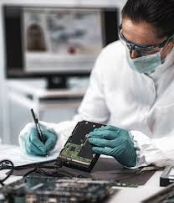
Goals of a Digital Forensics Examiner
As a digital forensics investigator, you should have a goal for investigation.
What is the crime and Evidence?
Where it can be found?
When was the crime committed ?
Who is the culprit of the crime?
How was the crime committed?

Slide 71
Principles of Digital Forensics
Principles of Digital Forensics
Securing the Crime Scene
Maintaining chain of custody
Limiting Evidence interaction

Slide 72
Digital Forensics Scientific Process

Slide 73
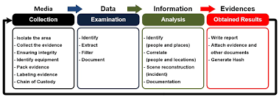
Digital Forensics Scientific Process:
Evidence Identification and collection.
Preservation.
Examination and Analysis.
Reporting.

Slide 74
Enterprise security specification

Slide 75
Enterprise security specification is a specification aimed at fomenting a minimum standard of security for enterprise applications.
Updated Security Applications (firewalls, proxies, antivirus software, etc.) Network Architecture Design (and review) Endpoint Controls & Analysis

Slide 76
Major Types of Enterprise CyberSecurity Tools
Network Firewall.
Application Firewall.
Anti-Virus Software (AV) .
Network Proxy.
Endpoint Detection and Response (EDR) .
Vulnerability Patching.
Intrusion Detection and Protection Systems (IDS/IPS) .
Role-Based Access Control (RBAC)

Slide 77
